Slide 1
Scheduling
Minimizing time in the system
Scheduling with deadlines

Slide 2
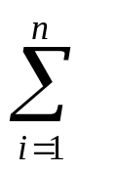
Minimizing time in the system
Assume we submit n jobs into a system at the same time.
  The service time of job i, t_{i}, know in advance
Problem
  Design an algorithm that minimizing the average response time
  This is equivalent to
    Minimizing the total response time
    T = (response time of job j)

Slide 3
A greedy algorithm
Algorithm
  Sort the jobs by their service times
  Repeat
    Serve the job with minimal service time among the remaining jobs
Analysis
  Step 1: O(n log n)
  Step 2: Θ(n)
  Total: O(n log n)

Slide 4
Optimality of the greedy scheduling algorithm
Theorem 6.6.1. The greedy algorithm is optimal
1..a-1
a
a+1..b-1
b
b+1..n
P
exchange a and b
P’
1..a-1
b
a+1..b-1
a
b+1..n
Compares schedules P and P’, job a at P’ leaves at the same time
as job b in P. Jobs b and a+1 to b-1 in P’ leaves earlier then the corresponding
jobs in P.

Slide 5
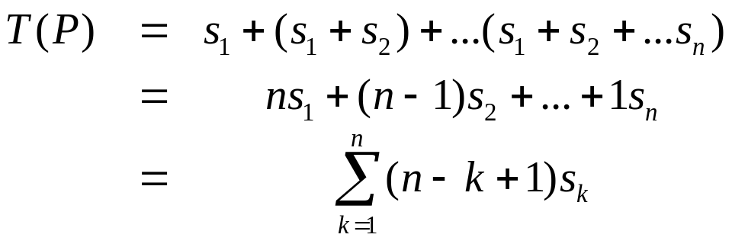
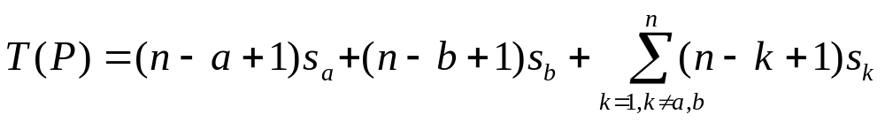
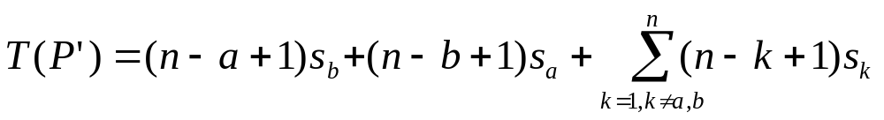
Optimality of the greedy scheduling algorithm

Slide 6
Scheduling with deadlines
We have a set of jobs to execute, each of which take unit time.
No concurrency and parallel: at any time we can execute exactly one job
Job i earn us a profit g_{i} > 0 if and only if it is executed no later than time d_{i}
Problem: find a scheduling that maximize the total profits.

Slide 7
Example
i | 1 | 2 | 3 | 4
g_{i} | 50 | 10 | 15 | 30
d_{i} | 2 | 1 | 2 | 1
Sequence | Profit | Sequence | Profit
1 | 50 | 2, 1 | 60
2 | 10 | 2, 3 | 25
3 | 15 | 3, 1 | 65
4 | 30 | 4, 1 | 80
1, 3 | 65 | 4, 3 | 45
Optimum

Slide 8
A greedy algorithm
Feasible
  A set of jobs is feasible if there exists at least one sequence (also called feasible) that allows all jobs in the set to be executed no late than their respective deadlines.
Greedy algorithm
  At each step, add the job with the highest profit (g_{i}) among those not yet considered, providing that the chosen set of jobs remains feasible.
Theorem: the greedy algorithm above is optimal

Slide 9
Proof of the optimality of the greedy algorithm
Suppose the greedy algorithm choose the set of jobs I, and the set J is optimal. Let S_{I} and S_{J} be feasible sequences, possibly including gaps
  Rearrange the jobs in S_{I} and S_{J}, we can obtain two feasible sequences S_{I}’ and S_{J}’, such that every job common to I and J is scheduled at the same time in both sequences
  Compare each pair of slots at the same time and show that I’ and J’ yield the same profit

Slide 10
Rearranging Jobs, case I
Job a occurs in both feasible sequences and is scheduled at time t_{I} and t_{J} respectively
  t_{I} = t_{J}, we do not need to do anything
t_{I} = t_{J}
S_{I}
 |  |  |  |  | a
S_{J}
 |  |  |  |  | a

Slide 11
Rearranging Jobs, case II
Job a occurs in both feasible sequences and is scheduled at time t_{I} and t_{J} respectively
  t_{I} < t_{J}, we will try to move job a at t_{I} to the slot t_{J}
    Slot t_{J} is a gap. Simply move
    Job b is at slot t_{J}. Exchange job a and b.
t_{I}
t_{J}
S_{I}
 |  | a |  |  | b
S_{J}
 |  |  |  |  | a

Slide 12
Rearranging Jobs, case III
Job a occurs in both feasible sequences and is scheduled at time t_{I} and t_{J} respectively
  t_{I} > t_{J}, similar to case II.

Slide 13
Compare jobs in the rearranged sequences
If some job a is schedule in S_{I}’ opposite a gap in S_{J}’, a does not belong J. J  {a} is a feasible sequence and more profitable.
If some job b is scheduled in S_{J}’ opposite a gap in S_{I}’. The set I  {b} will be feasible and the greedy algorithm would have included b in I.
The only remaining possibility is that some job a is schedules in S_{I}’ opposite a different job b in S_{J}’.
  g_{a} > g_{b}. J is not optimal
  g_{a} < g_{b}. The greedy algorithm should have chosen b first.
  The only remaining possibility is g_{a}=g_{b}.

Slide 14

Lemma
Let J be a set of jobs. Suppose without loss of generality that the jobs are numbered so that
Then the set J is feasible if and only if the sequence 1, 2, …, k is feasible
  Key to the proof: the pigeonhole principle

Slide 15
An implementation
Sequence(d[n+1])
{
// assuming the profit is sorted in decreasing order
d[0] = s[0] = 0; // sentinels
s[1] = 1; // the first job is scheduled
k = 1; // # jobs already scheduled
for (i=2; i<=n; i++) { // try job i
// invariant: d[s[0]] <= d[s[1]]…<=d[s[k]]
r = k;
while (d[s[r]] > max(d[i], r)) r--; // r+1 is the earliest slot for job i
if (d[i] > r) { // feasible if insert i
for (j=k; j>r; j--)
s[j+1] = s[j];
s[r+1] = i;
k++;
}
}
return s;
}
Worst
Case:
O(n²)

Slide 16
Example
i | 1 | 2 | 3 | 4 | 5 | 6
g_{i} | 20 | 15 | 10 | 7 | 5 | 3
d_{i} | 3 | 1 | 1 | 3 | 1 | 3
d[s[i]]
3
Initialization:
1
s[i]
1
3
Try 2
2 | 1
Try 3
unchanged
1
3
3
Try 4
2 | 1 | 4
Try 5, 6
unchanged
Optimal sequence: 2, 1, 4

Slide 17
A more efficient algorithm begins with the lemma below
Lemma 6.6.4
  A set of jobs J is feasible if and only if we can construct a feasible sequence including all the jobs in J as follows. Start with an empty schedule of length n. Then for each job i  J in turn, schedule i at time t, where t is the largest integer such that 1 t  min(n, d_{i}) and the job to be executed at time t is not yet decided.
    The “if” is obvious
    The “only if”

Slide 18
Proof of “only of”
If the sequence is feasible, then it can be schedule in n slots.
When we try to add a new job, the sequence being built always contains a gap
Assume by contradiction that we are unable to add a job of deadline d
  s is the next available gap with s>d
  We can show that all scheduled jobs in slot 1 to s-1 have deadlines <= s-1, which results in s jobs with deadline <= s-1 and thus no schedule is feasible

Slide 19
Use disjoint set to construct feasible sequence
Positions of a set
 |  |  |  |  |  |  |  | …
…
i j
n_{t} = max{k  t | position k is free}
Two positions i and j are in the same set if n_{i} = n_{j}
F(K) is the smallest member of set K

Slide 20
Algorithm
Sequence2(d[n+1])
{
// assuming the profit is sorted
// in decreasing order
for (i=0; i<=n; i++) {
s[i] = 0;
F[i] = i;
initialize set i;
}
// greedy loop
for (i=1; i<=n; i++) { // try job i
k = find(min(n, d[i]));
m = F[k];
if (m != 0) {
s[m] = i;
l = find(m-1);
F[k] = F[l];
merge(k,l);
}
}
// compress the solution
k=0
for (i=1; i<=n; i++) {
if (s[i] >0) {
k = k+1;
s[k] = s[i];
}
}
return s;
}
Analysis: 2*n find and n merge
Cost: O(n (2n, n))
Sorting cost for the assumption.

Slide 21
Example
i | 1 | 2 | 3 | 4 | 5 | 6
g_{i} | 20 | 15 | 10 | 7 | 5 | 3
d_{i} | 3 | 1 | 1 | 3 | 1 | 3
Initialization:
l=min(6, max(d_{i})) = 3
F:
0
1
2
3
0
1
2
3

Slide 22
Example
i | 1 | 2 | 3 | 4 | 5 | 6
g_{i} | 20 | 15 | 10 | 7 | 5 | 3
d_{i} | 3 | 1 | 1 | 3 | 1 | 3
Try 1: d1=3, assign task 1 to position 3
F: 0 1 2
0
1
2
3
Try 2: d2=1, assign task 2 to position 1
F: 0 2
0
2
3
1

Slide 23
Example
i | 1 | 2 | 3 | 4 | 5 | 6
g_{i} | 20 | 15 | 10 | 7 | 5 | 3
d_{i} | 3 | 1 | 1 | 3 | 1 | 3
Try 3: d3=1, no free slot is available
Try 4: d4=3, assign task 4 to position 2
F: 0
0
2
3
1
Try 5 and try 6, no free position is available

